Slide 1
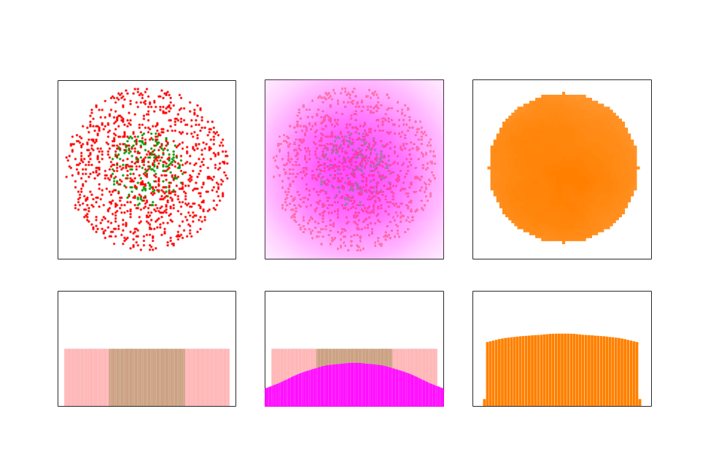
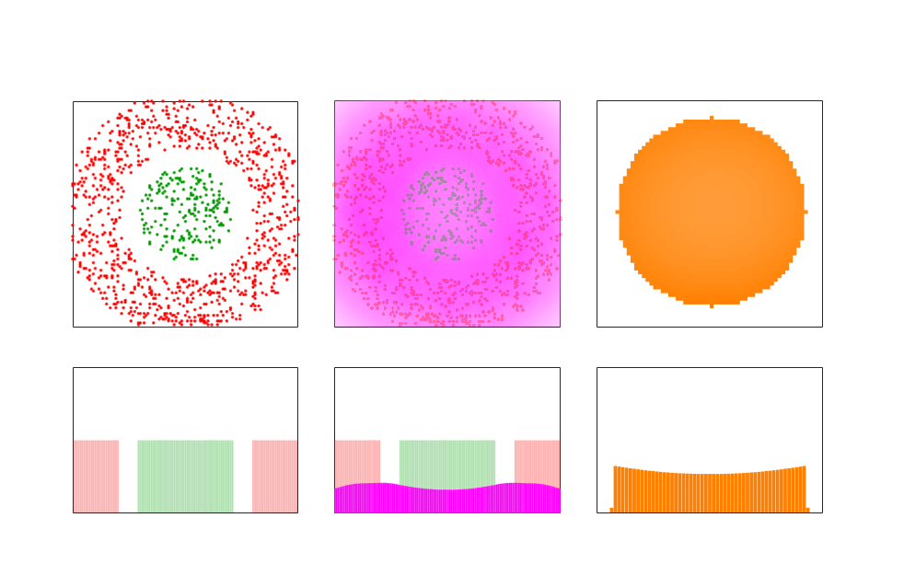
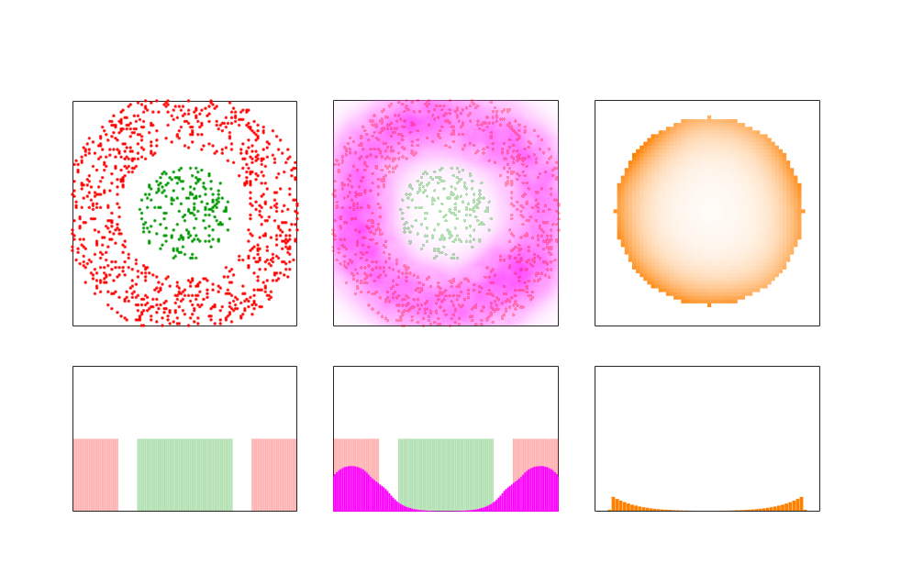
Figure 1
A
Spatial pattern
B
Lck activity
C
TCR phosphorylation
TCR
CD45
500 nm
500 nm
250 nm
D
Spatial pattern
E
Lck activity
F
TCR phosphorylation
G
Spatial pattern
H
Lck activity
I
TCR phosphorylation
Notes:
Figure 1. TCR phosphorylation as a function of depletion distance between TCR and CD45 (depletion distance) and the decay-length of the Lck activity.
1A) Top: Concentric circles of TCR (green) and CD45 (red). The radius of the TCR circle is 250nm, the radius of the CD45 circle is 450nm, the depletion distance is -250nm.
1B) Top: At the location of every CD45 molecule we drew an Lck activity distribution with a decay-length of 200nm. The magenta cloud represents the overall Lck activity that is the sum over all the individual Lck activity distributions around the CD45 molecule.
1C) Top: Enlarged view of the gray square in B. It shows the level of TCR phosphorylation with averaging over angles around the TCR circle’s center.
A, B, C Bottom are cross-sections of the distributions in A, B, C top.
1D) Top: The radius of the TCR circle is 250nm. The inner radius of the CD45 ring is 350nm the outer radius of the CD45 ring is 550nm, the depletion distance is 100nm.
1E) Top: The decay-length of the active Lck distribution is the same as in B, (200nm).
1F) Top: Enlarged view of the gray square in E. It shows a slightly different phosphorylation pattern than the one in C.
D, E, F Bottom is a cross sections of the distributions in D, E, F top.
1G) Top: the distribution of the TCR and CD45 molecules are the same as in D.
1H) Top: The decay-length of the active Lck distribution 50nm.
1I) Top: Enlarged view of the gray square in H, It shows a very different phosphorylation pattern than the ones in C and F.
G, H, I Bottom is a cross sections of the distributions in G, H, I top.

Slide 2
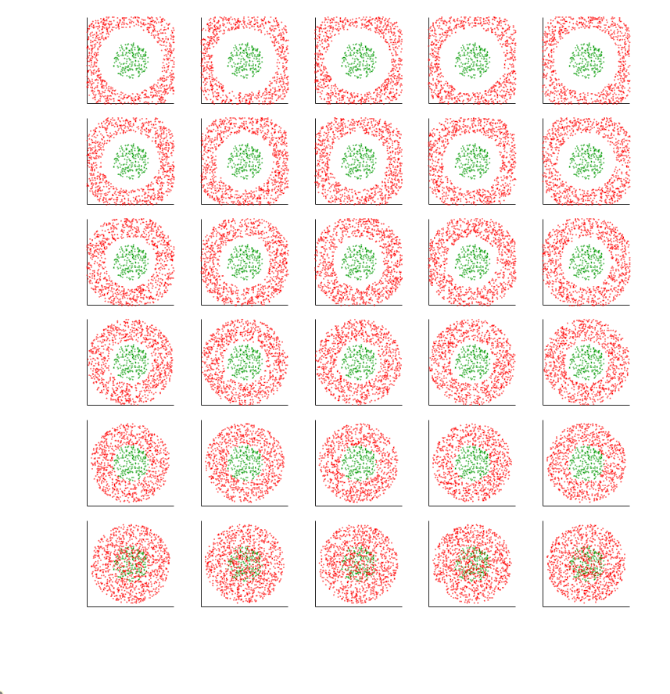
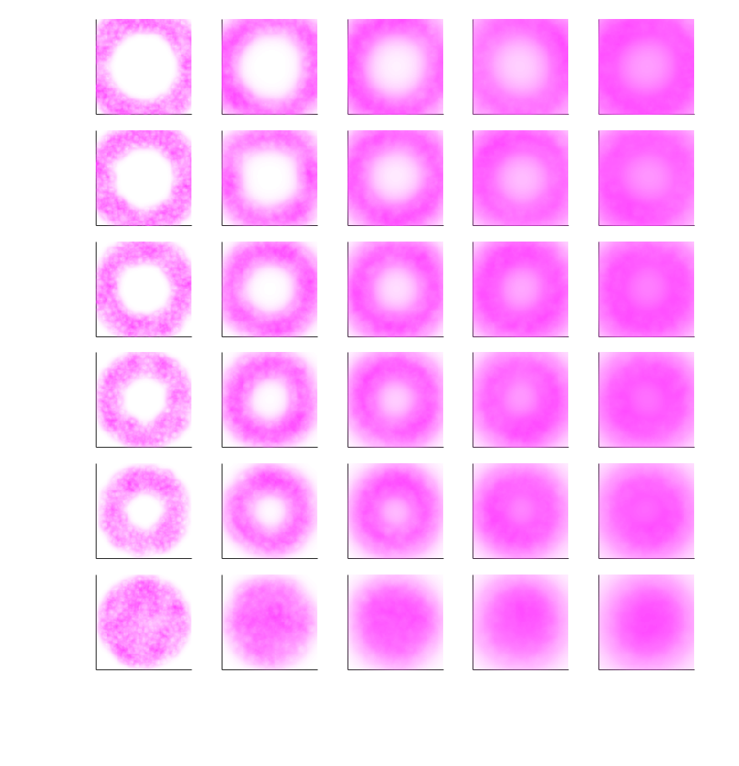
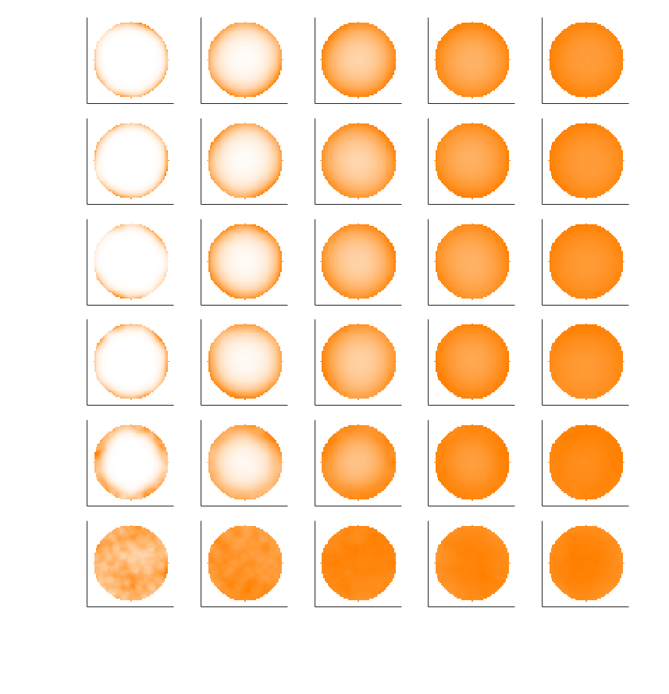
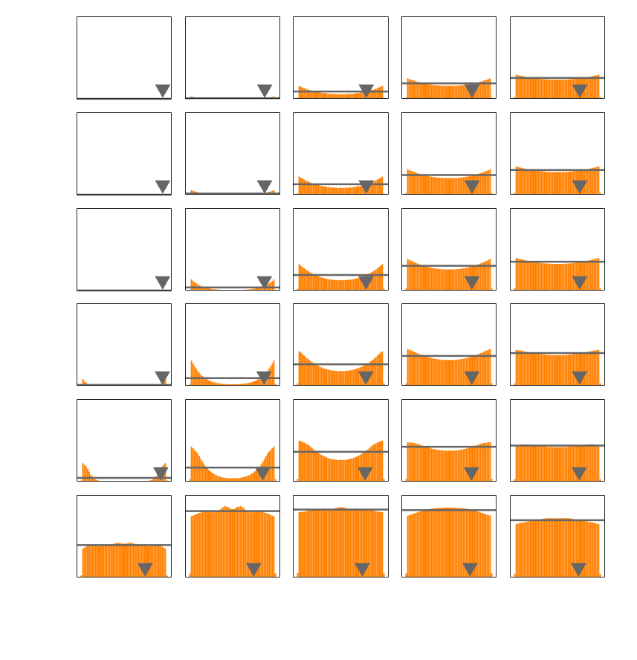
Figure 2
A
Spatial pattern
B
Lck activity
200
200
150
150
100
1C
1B
100
1C
1B
Depletion (nm)
Depletion (nm)
50
50
0
0
-250
CD45
TCR
1A
-250
1A
500 nm
500 nm
20
50
100
150
200
C
D
Decay length (nm)
TCR phosphorylation
TCR phosphorylation profile
200
200
150
150
100
1C
1B
100
1C
1B
Depletion (nm)
Depletion (nm)
50
50
0
0
-250
1A
-250
1A
250 nm
50
100
150
200
250 nm
20
Decay length (nm)
20
50
100
150
200
Decay length (nm)
Notes:
Figure 2.
2A) Different distribution of TCR and CD45 molecules. The TCR circle and the CD45 ring are concentric. All the TCR circles has a diameter of 500nm. The bottom row (red frame) show a naïve assumption of mixing between TCR and CD45 where the CD45 circle has a diameter of 1100nm. In the rows above, the CD45 rings has a width of 300nm. All the columns are identical and at every row the depletion distances (distance between the edge of the TCR circle and the inner edge of the CD45 ring), changes from 0 to 200nm.
2B) At the location of every CD45 molecule we draw a Lck activity distribution with a certain decay-length. The overall Lck activity distribution is the sum of all the individual distributions. The decay-length values are the same for every row and have different values from every column from 20 to 200nm.
2C) The orange circles mark the distribution area of the TCR molecules. The gradient in the orange color signifies the phosphorylation of the TCR molecules.
2D) Profile of circles in 2C. The gray triangles mark the location of the expected value of the radial TCR phosphorylation. The gray lines mark the average level TCR phosphorylation.

Slide 3
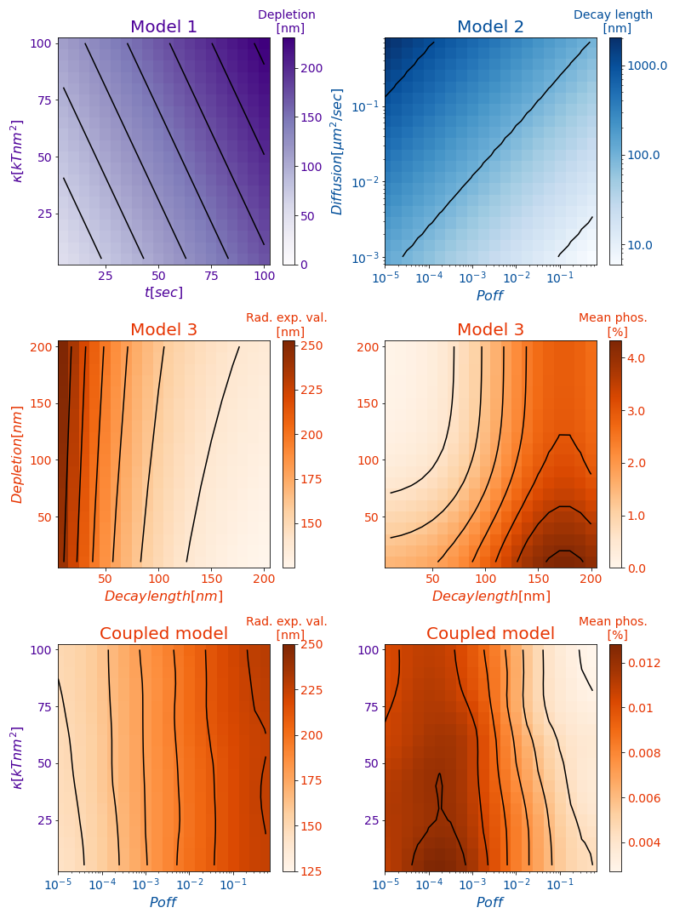
A
B
C
D
E
F
Notes:
Figure 3.
3A) Surrogate model for model 1.
3B) Surrogate model for model 2.
3C, 3D) Surrogate models for model 3.
3E, 3F) Coupled model. The input of x axis is the input of model 2, the input of y axis is the input of model 1. The outputs are the outputs of model 3.

Slide 4
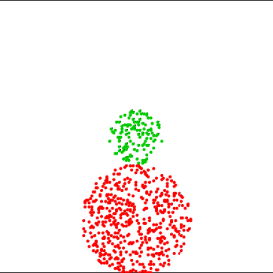
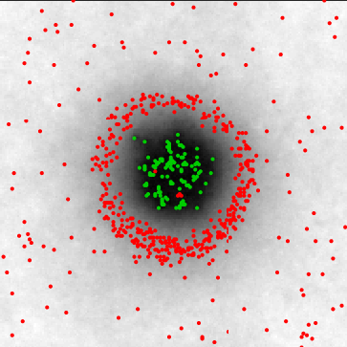
Fig. S1 - Model 1 – kinetic segregation (KSEG) – Physical model + InterCells
A
Physical model
T-cell
i,j
CD45
TCR
Δz_{i,j}
pMHC
APC
B
Interactions
C
T-cell (initial)
D
T-cell (final)
Δz(nm)
2000
70 nm
50
40
Attraction
Repulsion
1000
30
Y(nm)
20
10
t = 0
t = 100sec
0 nm
0
0
2000
0
K_{B}T
0
1000
0
1000
2000
X(nm)
X(nm)
Notes:
Fig. S1.
Side view of the simulation setup. TCR and pMHC molecules perform a binding interaction when their xy coordinates match (occupying the same i,j square). CD45 molecules act as repulsing springs when Δz_{i,j} is smaller than the CD45 resting length.
B. Interaction potentials: When a TCR and a pMHC are at the same i,j square, their inter will be fixed at Δz = 13nm. CD45 acts as spring with a spring constant of 0.1 kT/nm₂ and resting length of 50nm. When 45nm < Δz_{i,j} < 55nm the molecules bind to the APC surface. When Δz_{i,j} > 55nm there is no interaction.
C. initial conditions of the simulations. N_{TCR} ~ 125, N_{CD45} ~ 500, The inter-membranes distance, Δz = 70nm (white color) except at the locations of the molecules, where for the CD45 locations Δz = 50nm (resting length of CD45 molecule) and at the TCR locations Δz = 13nm (length of bound TCR-pMHC). pMHC molecules (not shown here) are uniformly scattered over the APC membrane with surface density of 300/μm².
D. molecules distribution and topography after 10,000 iterations (100 sec). The gray colorbar represents the inter-membranes distance.

Slide 5
Fig. S2 - Model 1 – kinetic segregation (KS) – Pair correlation function
A
B
Notes:
We calculated the univariate pair correlation functions, g₁₁(r), g₂₂(r) and the bivariate pair correlation function g₁₂(r). We characterized each g(r) curve by a single value. For g₁₁(r) and g₂₂(r) we used the width at Δg/2 where Δg/2 is the difference between minimum and maximum of g(r) (fig. S1 H). For g₁₂(r) we used the same method but with the distance to the nearest curve intersection as the depletion distance (fig S1 I). With these three single value data sets we created three maps (fig. S2 A-C).

Slide 6
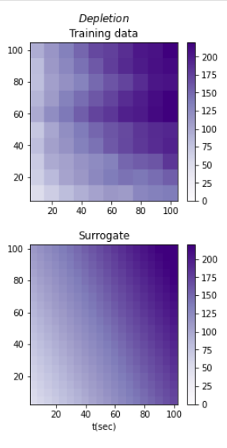
Fig. S3 - Model 1 – kinetic segregation (KS) – Evidence, trained
A
200
150
100
50
0
Units,
Font size,
Font type
B
200
150
100
50
0
Notes:
Fig. S2. Getting a single value that characterizes the depletion range between TCR and CD45.
S2A) Heatmap of the evidence (training data) for the depletion distance between TCR and CD45.
S2B) Heatmap of the fitted model after running the PyMC3 package with the validated equations and random variables.

Slide 7
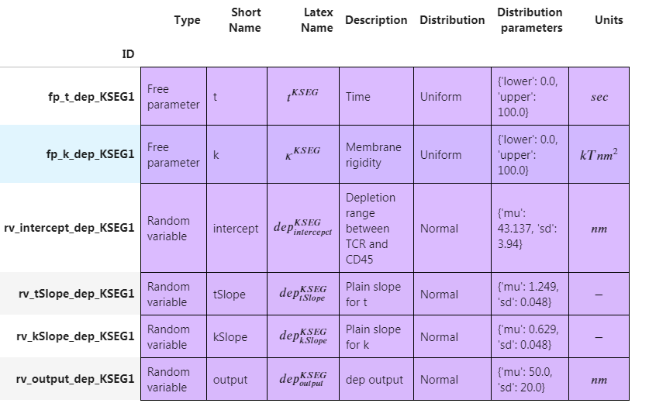
Model1
Untrained model
Notes:
Table. ST1. Summary of all the parameters that describes the untrained model1

Slide 8
Model1
Trained model
Notes:
Table. ST2. Summary of all the parameters that describes the trained model1

Slide 9
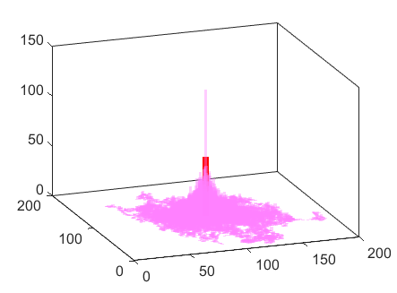
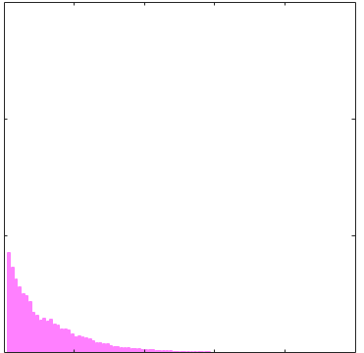
Fig. S4 –Model 2 – Lck activation (LA) – Model + MC simulations
A
B
C
random walk and activation
Active LCK distribution
150
Radial density of active LCK
CD45
Counts
100
Lck*
CD45
CD45
Radial density
Lck
Lck*
50
Deactivation
Y(nm)
Lck*
0
X(nm)
0
500
1000
r(nm)
Notes:
Fig. S3. Lck activation as a result of an interaction with CD45.
S3A. The red point marks the location of a CD45 molecule. All Lck’s paths begin at an active state at the CD45 location. As they propagate in a two dimensional random walk they are being spontaneously deactivated with a probability Poff at every step.
S3B. The magenta (orange) paths mark the locations of active Lck and the heights of the bars mark how many times active Lck molecules passed through this location (bin) during the simulation (paths of inactive Lck are not shown).
S3C. Radial distribution of the locations of active Lck. The radial distribution is calculated as the sum over angles of the active Lck around the location of the CD45. The radial distribution behaves as an exponential decay function and depends on the D_{Lck} and Poff_{Lck*}.

Slide 10
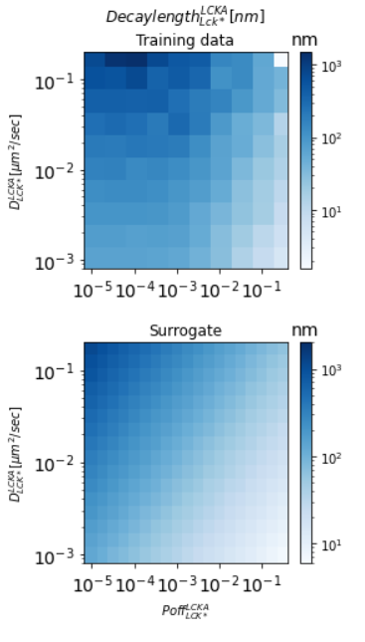
Fig. S5 - Model 2 – Lck activation(LCKA) – Evidence, trained
A
B
Notes:
Fig. S5. Getting a single value that characterizes the decay length of active Lck.
S5A) Heatmap of the training data for the decay length of Lck*. X axis is log₁₀ of the deactivation probability per iteration time. Y axis is log₁₀ of the diffusion coefficient of the Lck molecules.
S5B) Heatmap of the fitted model after running the PyMC3 package with the validated equations and random variables.

Slide 11
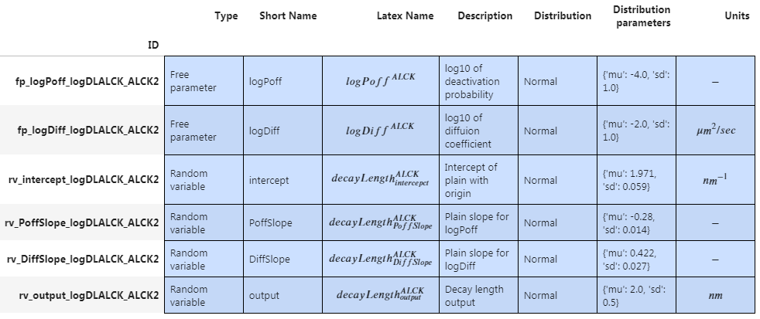
Model2
log₁₀decaylength
Notes:
Table. ST3. Summary of all the parameters that describes the untrained model2

Slide 12
Model2
log₁₀decaylength
Notes:
Table. ST4. Summary of all the parameters that describes the trained model2

Slide 13
Fig. S7 - Model 3 – TCR phosphorylation (TP) – output data
A
B
C
No phosphorylation
Non uniform Phosphorylation
Uniform Phosphorylation
CD45
CD45
CD45
Lck* activity
Lck* activity
Lck* activity
TCR
TCR
TCR
TCR*
TCR*
TCR*
Notes:
Fig. S6. Phosphorylation of TCR as a results of the distance between TCR and CD45 (depletion) and the decay length of Lck activity.
S6A) Short decay-length of Lck activity, no TCRs are phosphorylated.
S6B) Medium decay-length of Lck activity, TCRs close to CD45 molecules are phosphorylated, TCRs far from CD45 molecules are not phosphorylated.
S6C) Long decay-length of Lck activity, TCRs close to and far away from CD45 molecules are phosphorylated.

Slide 14
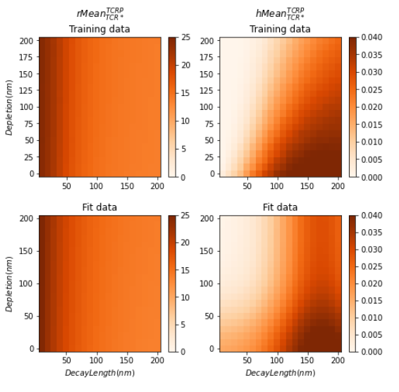

Slide 15
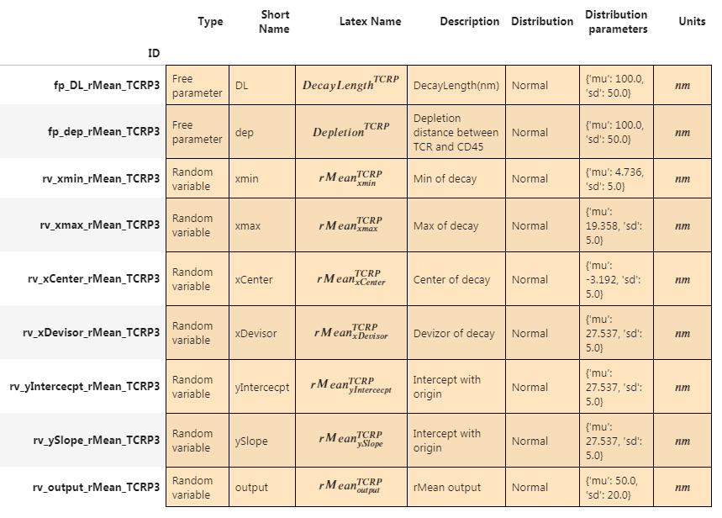
Model3
rMean

Slide 16
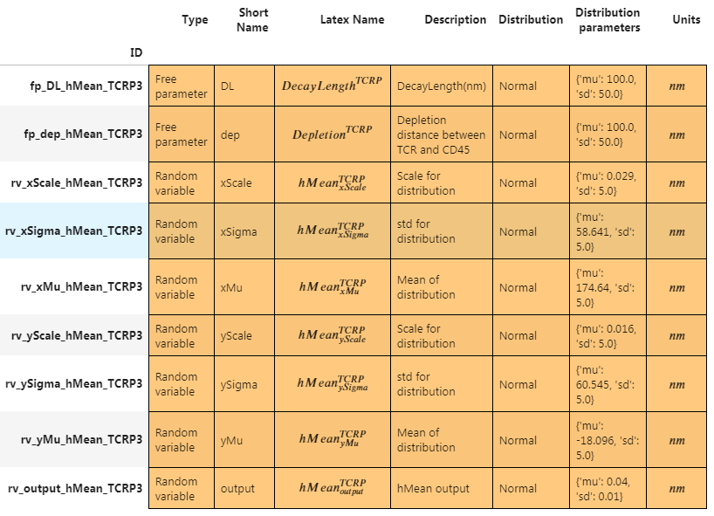
Model3
hMean

Slide 17
End

Slide 18
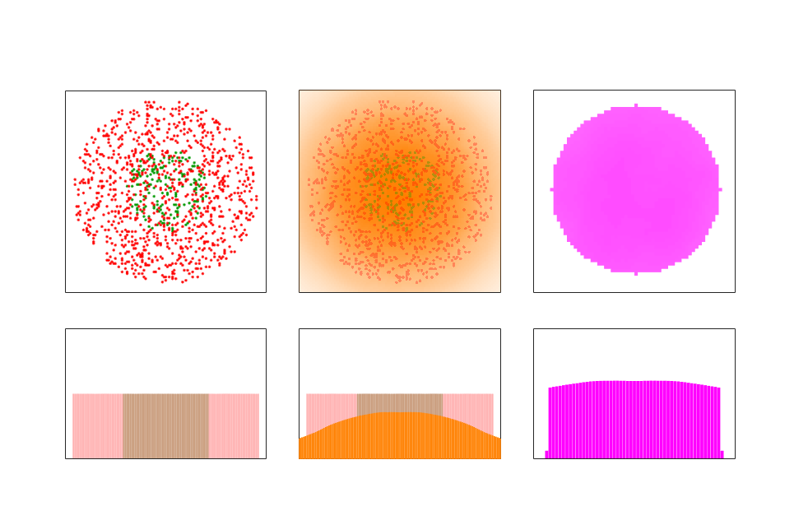
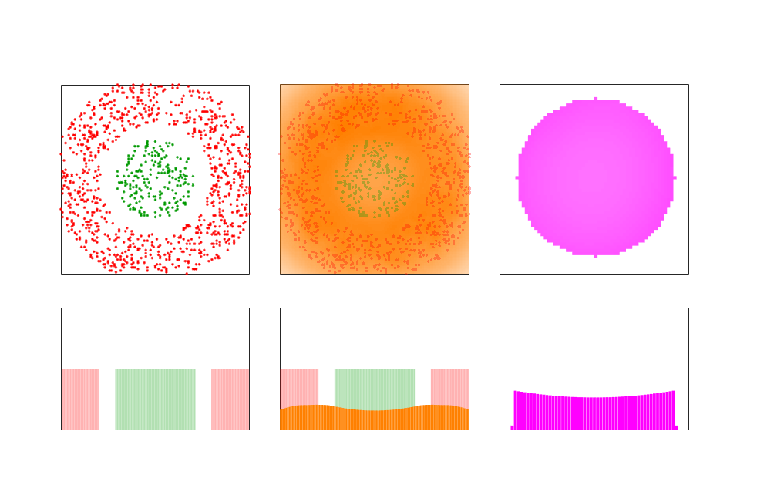
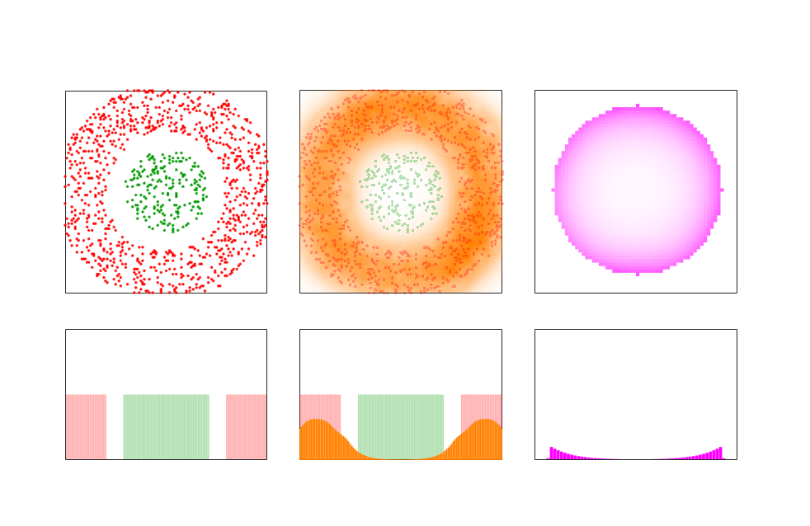
Figure 1
A
Spatial pattern
B
Lck activity
C
TCR phosphorylation
TCR
CD45
500 nm
500 nm
250 nm
D
Spatial pattern
E
Lck activity
F
TCR phosphorylation
G
Spatial pattern
H
Lck activity
I
TCR phosphorylation
Notes:
Figure 1. TCR phosphorylation as a function of depletion distance between TCR and CD45 (depletion distance) and the decay-length of the Lck activity.
1A) Top: Concentric circles of TCR (green) and CD45 (red). The radius of the TCR circle is 250nm, the radius of the CD45 circle is 450nm, the depletion distance is -250nm.
1B) Top: At the location of every CD45 molecule we drew an Lck activity distribution with a decay-length of 200nm. The orange cloud represents the overall Lck activity that is the sum over all the individual Lck activity distributions around the CD45 molecule.
1C) Top: Enlarged view of the gray square in B. It shows the level of TCR phosphorylation with averaging over angles around the TCR circle’s center.
A, B, C Bottom are cross-sections of the distributions in A, B, C top.
1D) Top: The radius of the TCR circle is 250nm. The inner radius of the CD45 ring is 350nm the outer radius of the CD45 ring is 550nm, the depletion distance is 100nm.
1E) Top: The decay-length of the active Lck distribution is the same as in B, (200nm).
1F) Top: Enlarged view of the gray square in E. It shows a slightly different phosphorylation pattern than the one in C.
D, E, F Bottom is a cross sections of the distributions in D, E, F top.
1G) Top: the distribution of the TCR and CD45 molecules are the same as in D.
1H) Top: The decay-length of the active Lck distribution 50nm.
1I) Top: Enlarged view of the gray square in H, It shows a very different phosphorylation pattern than the ones in C and F.
G, H, I Bottom is a cross sections of the distributions in G, H, I top.

Slide 19
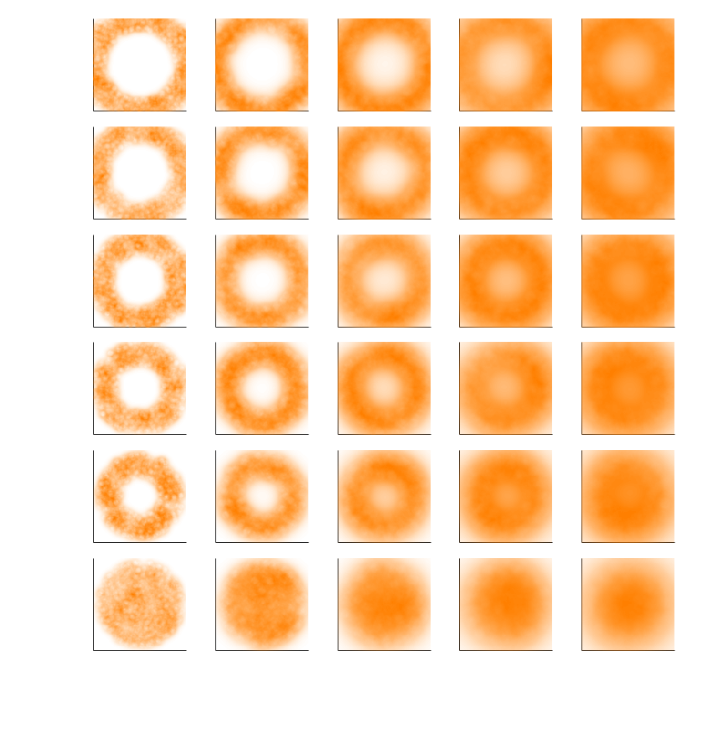
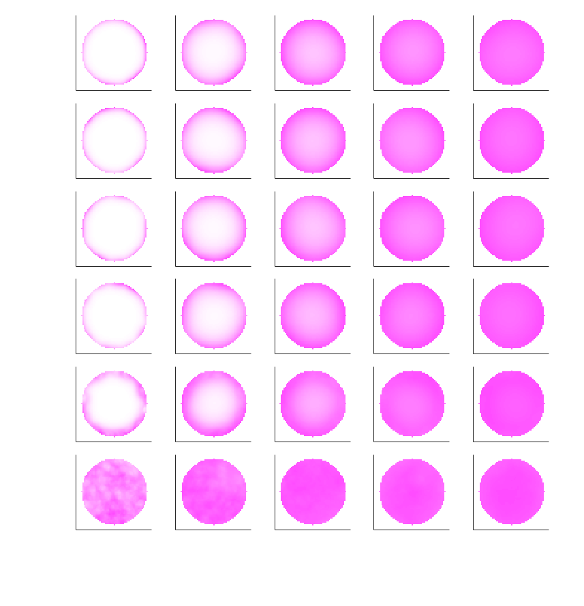
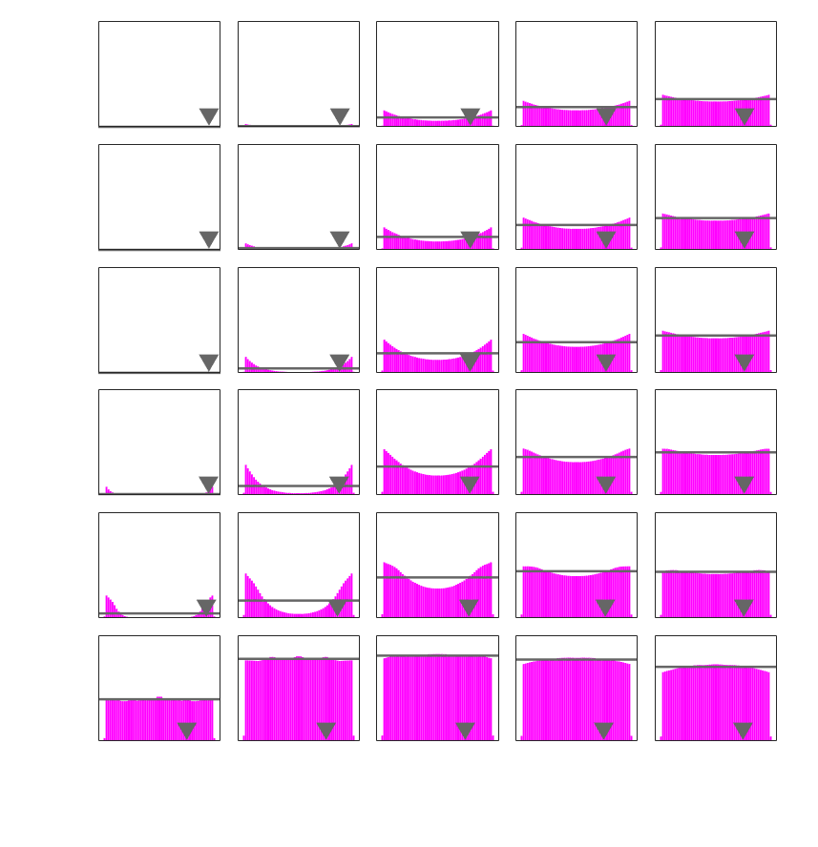
Figure 2
A
Spatial pattern
B
Lck activity
200
200
150
150
100
1C
1B
100
1C
1B
Depletion (nm)
Depletion (nm)
50
50
0
0
-250
CD45
TCR
1A
-250
1A
500 nm
500 nm
20
50
100
150
200
C
D
Decay length (nm)
TCR phosphorylation
TCR phosphorylation profile
200
200
150
150
100
1C
1B
100
1C
1B
Depletion (nm)
Depletion (nm)
50
50
0
0
-250
1A
-250
1A
250 nm
50
100
150
200
250 nm
20
Decay length (nm)
20
50
100
150
200
Decay length (nm)
Notes:
Figure 2.
2A) Different distribution of TCR and CD45 molecules. The TCR circle and the CD45 ring are concentric. All the TCR circles has a diameter of 500nm. The bottom row (red frame) show a naïve assumption of mixing between TCR and CD45 where the CD45 circle has a diameter of 1100nm. In the rows above, the CD45 rings has a width of 300nm. All the columns are identical and at every row the depletion distances (distance between the edge of the TCR circle and the inner edge of the CD45 ring), changes from 0 to 200nm.
2B) At the location of every CD45 molecule we draw a Lck activity distribution with a certain decay-length. The overall Lck activity distribution is the sum of all the individual distributions. The decay-length values are the same for every row and have different values from every column from 20 to 200nm.
2C) The magenta circles mark the distribution area of the TCR molecules. The gradient in the magenta color signifies the phosphorylation of the TCR molecules.
2D) Profile of circles in 2C. The gray triangles mark the location of the expected value of the radial TCR phosphorylation. The gray lines mark the average level TCR phosphorylation.

Slide 20
Fig. S7 - Model 3 – TCR phosphorylation (TP) – output data
A
B
C
Non-phosphorylated TCR
Phosphorylated TCR
Non-phosphorylated TCR
CD45
CD45
CD45
Lck* activity
Lck* activity
Lck* activity
Decay length
TCR
TCR*
TCR
Depletion

Slide 21
Fig. S7 - Model 3 – TCR phosphorylation (TP) – output data
Non-phosphorylated TCR
Phosphorylated TCR
Non-phosphorylated TCR
CD45
Lck* activity
TCR
CD45
Lck* activity
TCR*
CD45
Lck* activity
TCR
CD45
Lck* activity
TCR
Membrane
CD45
Lck* activity
TCR*
Membrane
CD45
Lck* activity
TCR
Membrane
Decay length
Depletion

Slide 22
Fig. S7 - Model 3 – TCR phosphorylation (TP) – output data
A
B
C
Non-phosphorylated TCR
Phosphorylated TCR
Non-phosphorylated TCR
Lck* activity
Lck* activity
Lck* activity
TCR
CD45
TCR*
CD45
TCR
CD45
Plasma membrane
Decay length
Depletion

